Slide 1

Telco Customer Churn Analysis
Understanding Customer Behaviour to Reduce Churn
Presenter : KwangSuk Sul
Git-Hub :https://github.com/KoreanBeaver
Notes:
Hello my name is Kay Sul in Sutton London, was born in South Korea, moved to Australia spent teenage time, moved to the UK, studied International Hospitality Management at university of Surrey, after the first year dropped uni and went back to Korea joined the army for 2 years and I am here now. I have been working as IT Infra technician at Samsung before. While working the role had strong desire to study computer science field for long time and decided to start my journey and took my time to study Web development and Data tech. I recently completed a data tech bootcamp where I developed myself skills with data cleaning, visualisation, creating dashboard and making reports. Now I wish to jump into real world as starting data analyst to contribute earned skills and develop as data analyst. Please watch my presentation about Telecommunication company Telco Customer Churn Analysis.

Slide 2
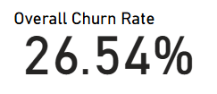
Overall Churn of Telco
Overall Churn Rate
1 customer every 4
Industry average churn rate of 20~25%
Total customers: 7043
Churn customers: 1869
Notes:
Churn customer means customers decide to leave the services. Looking at the card, Telco has average churn rate at 26.54% which is above industry average rate of 20% ~ 25%. This shows one customer out of 4 customers are leaving. I have analysed few data models to investigate the possible reasons.

Slide 3
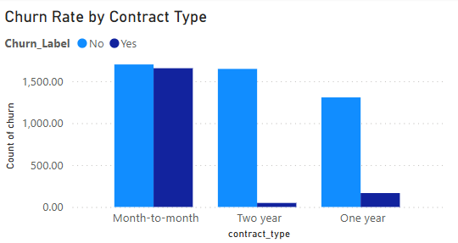
Churn Count by Contract Type
Month to Month has the highest churn numbers
Month to month - 1655
One Year – 166
Two Year – 48
Notes:
First, number of churn customers by contract types. There are 3 types of contact Telco provides to customers – Monthly, one year and two years contract. From the graph it clearly shows the majority churn customers are from monthly contract.

Slide 4
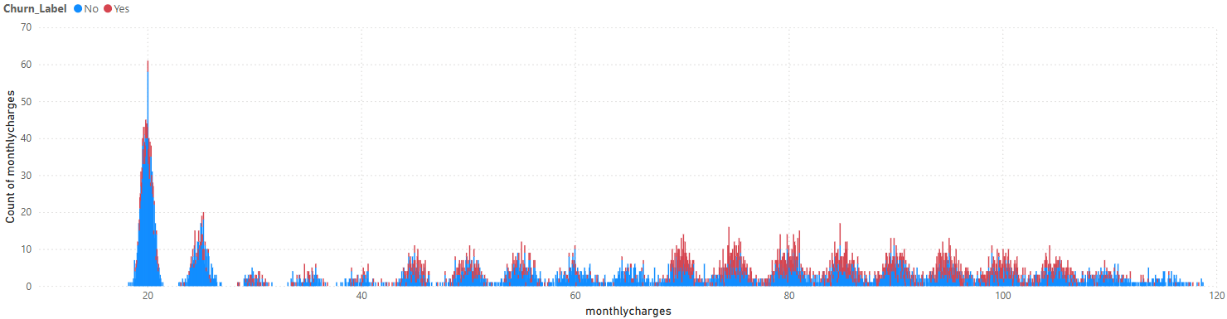
Monthly Charges Distribution by Churn
Churn customers are concentrated monthly charges between $70~$100
None churn customers are concentrated monthly charges between $20~$50
Higher price, higher chance of churn
Notes:
Second, churn customers by monthly charge amount. There are many products with different price range and churn customers are distributed in rage of 70 to 100 dollors the most according to the graph here.

Slide 5
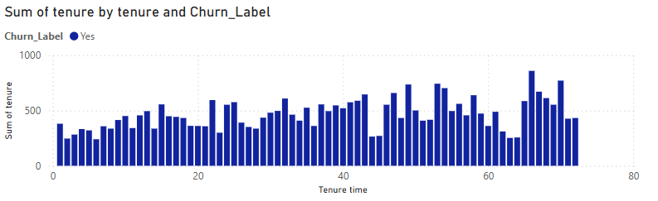
Tenure Distribution by Churn
Higher churn rate on customer less than 10 months
Experience in early stage seems important
Long term customers over 10 months has low churn rate
Notes:
Third, Tenure distribution. From the graph, can see majority of customers less than 10 months has highest number of leaving the services while customers over one 1 year has low Churn rate. This 1 year could be the key point.

Slide 6
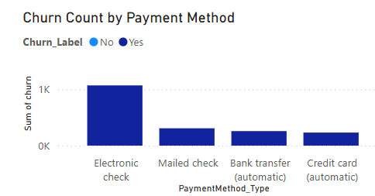
Notes:
As the last, this is the churn of customers by payment type. Clearly can see customers paying via electronic check has the highest churn numbers and credit cards has the lowest.

Slide 7
Churn Rate Above Average
Promotion Products for Long-Term Services
Future Strategies
Offer a discounted period for high-charge products
Sales Representative for early-stage customers
Adjust price or add service features for Early-stage
Discount on Credit Card Payment
Notes:
Now, these are my suggest for the business to reduce churn rate for the future. To break those 10 months key line and stay customers upto 1 year time, need promotion for 1 year period. This will naturally make more customers to stay longer.
For customers who are using high price products, create some promotional term or discount offers to reduce price for short-term time. Allocate sales representative for early stage customers to take extra care for first year would help customers to stay longer and also will help business to collect more accurate data for churn customers for the future.
The last, provide discount on price when use credit card as payment method. All suggestions were made from data analysis the dataset and hope the business can reduce churn rate for the future.

Slide 8
Q&A
Thank you
Notes:
I have analysed whole dataset to find possible reasons for churn customers and studied data to reach solutions to reduce churn customers for the business.

